Slide 1


Slide 2
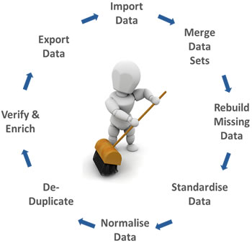
Data Cleaning by Definition…
Data cleansing or data cleaning is the process of detecting and correcting (or removing) corrupt or inaccurate records from a record set, table, or database and refers to identifying incomplete, incorrect, inaccurate or irrelevant parts of the data and then replacing, modifying, or deleting the dirty or coarse data

Slide 3
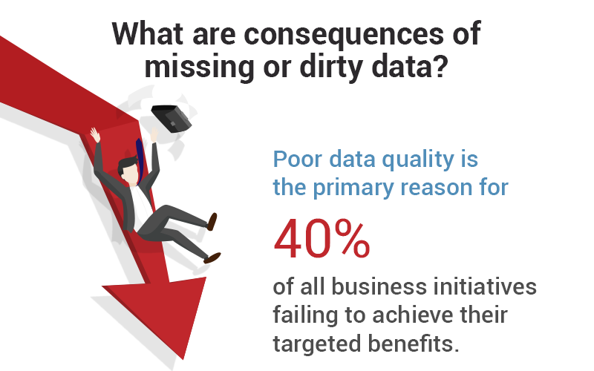

Slide 4
Categorical Variables
Dates
Characters
Continuous Variables
Missing Values; NA
Outliers
Tidy Data
DATA SET

Slide 5
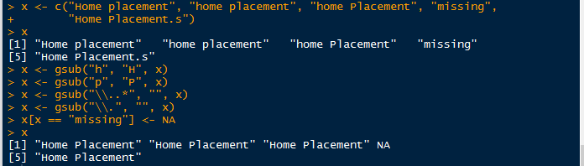

Let us clean the Characters First
Small ‘p’
Small ‘h’ & ‘p’
Small ‘h’
x <- c("Home placement", "home placement", "home Placement", "missing", "Home Placement.s")
Undesired word
Undesired dot
Undesired letter
We can also use the package stringr

Slide 6
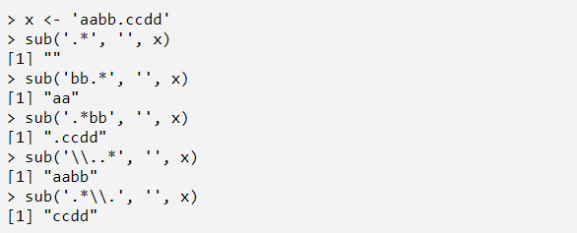
Let us clean the Characters First

Slide 7
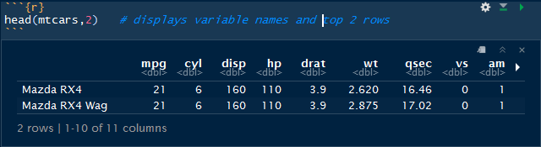
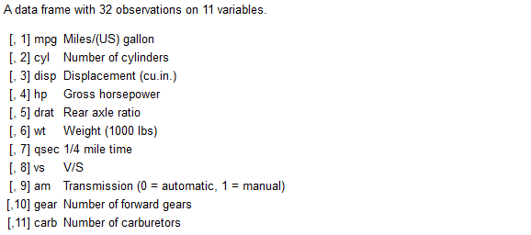
Categorical Variables
Let’s consider the data set ‘mtcars’
These Are Categorical Variables

Slide 8
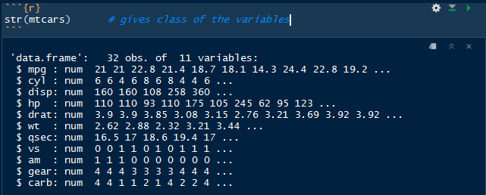
Categorical Variables
You can see here that categorical variables are stored as ‘numeric’.
Hence, we should convert them as factor for correct analysis

Slide 9
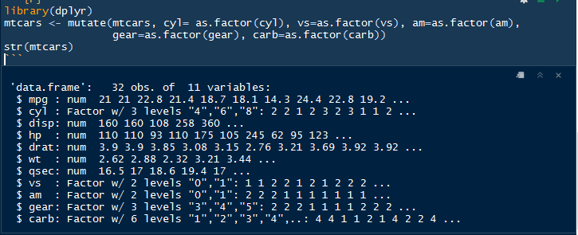
Categorical Variables
Use package dplyr to convert the variables as factor.
Above, you can see the variables ‘cyl’, ‘vs’, ‘am’, ‘gear’ & ‘carb’ are converted to factor.

Slide 10
Dates
Dates
Internally, Dates are stored as the number of days since 01.01.1970, using negative numbers for earlier dates. The as.numeric function can be used to convert a Date object to its internal form.
POSIXct
The POSIXct class stores date /time values as the numbers of seconds since January 1970
POSIXlt
The POSIXlt class stores date/time values as list with elements for second, minute, hour, day, month and year

Slide 11
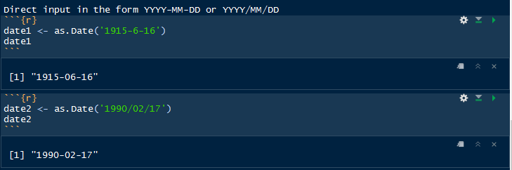
Dates

Slide 12
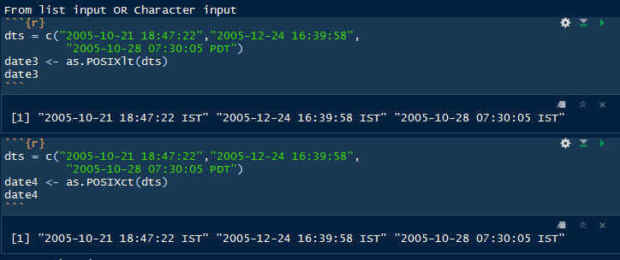
Dates

Slide 13
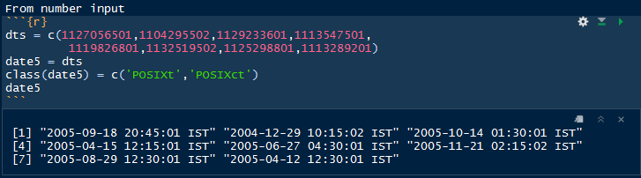
Dates

Slide 14
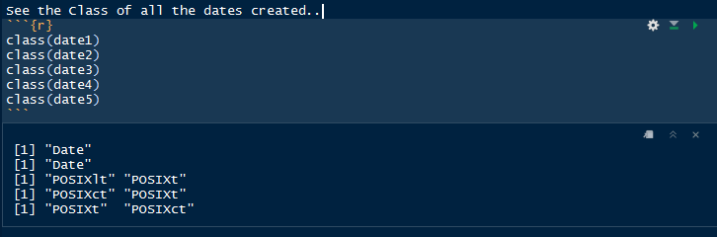
Dates
Data set given may contain any type of date or mix type of dates or even some missing values

Slide 15
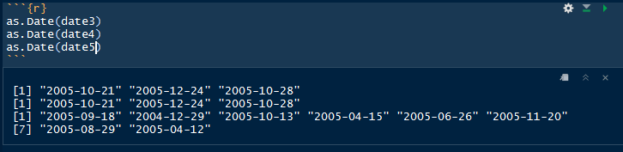
Cleaning Dates
First step is to convert all the dates to as single type /class using function as.Date

Slide 16
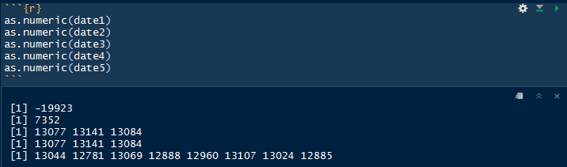
Cleaning Dates
In second step convert all the dates to numbers ( as it is stored internally by R) using function as.numeric
Advised to insert new column in data set for ‘numeric values of dates’ without disturbing the original one. Later in this PPT we will see how to tackle the ‘NA’ values in dates variable.

Slide 17
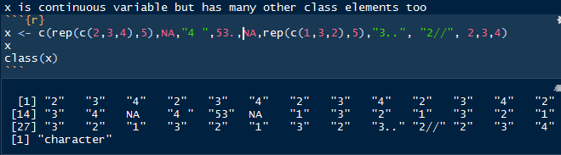
Continuous Variables
These must be of numeric / integer class
But many of times will be having unwanted characters, space, double dots, slash, etc
Stored as Character

Slide 18
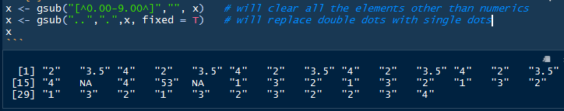
Clean Continuous Variables
First clear the characters
Though all the elements other than numeric are cleared, But still the vector is character class

Slide 19
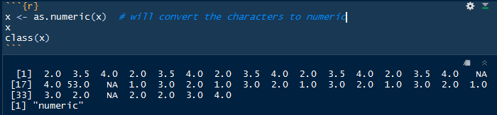
Clean Continuous Variables
Convert the class as numeric
Converted as numeric

Slide 20
Categorical Variables
Dates
Characters
Continuous Variables
Missing Values; NA
Outliers
Up till now we have cleaned
Next Task is to compute the Missing Values; NA

Slide 21
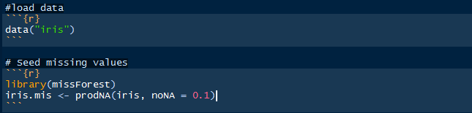
Handling Missing Values
Lets take the data set ‘iris’ and add some missing values to it in order to understand the methods..
Now we have the dataset iris.mis with random missing values

Slide 22
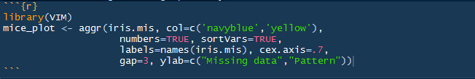
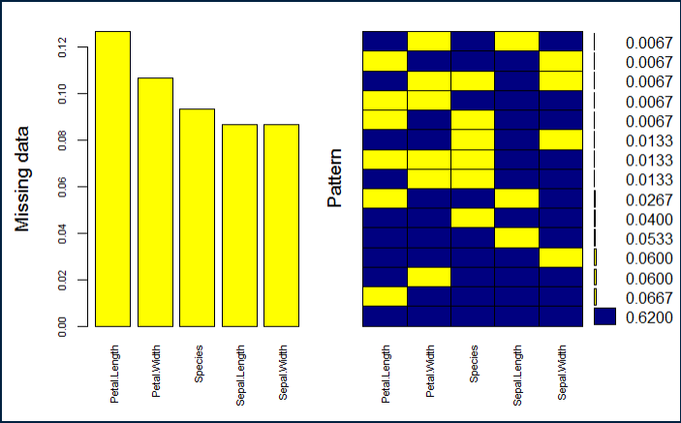
Handling Missing Values
How to check the missing values

Slide 23
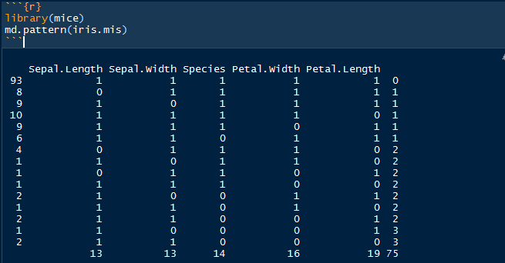
Handling Missing Values
How to check the missing values
Let’s understand this table. There are 93 observations with no missing values. There are 8 observations with missing values in Sepal.Length. Similarly, there are 9 missing values with Sepal.Width and so on.

Slide 24
Imputing the Missing Values
Option 1 - HMISC
1
automatically recognizes the variables types and uses bootstrap sample and predictive mean matching to impute missing values
2
It assumes linearity in the variables being predicted
3
multiple purpose package useful for data analysis, high – level graphics, imputing missing values, advanced table making, model fitting & diagnostics
Fisher’s optimum scoring method is used for predicting categorical variables

Slide 25
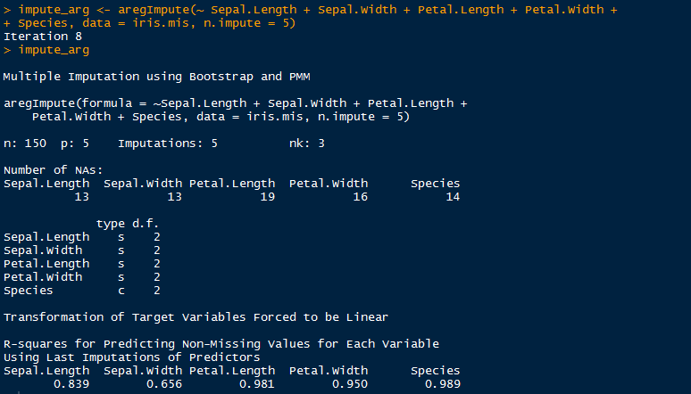
Imputing the Missing Values
The output shows R² values for predicted missing values. Higher the value, better are the values predicted.

Slide 26
Imputing the Missing Values
Option 2 - missForest
1
it tries to estimate f such that it can be as close to the data points
2
it builds a random forest model for each variable. Then it uses the model to predict missing values in the variable with the help of observed values
3
it provides high level of control on imputation process
It very well takes care of missing value pertaining to their variable types

Slide 27
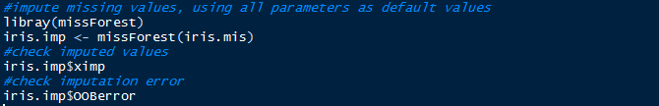


Imputing the Missing Values
NRMSE (normalized mean squared error) is used to represent error derived from imputing continuous values. PFC (proportion of falsely classified) is used to represent error derived from imputing categorical values.
This suggests that categorical variables are imputed with 6% error and continuous variables are imputed with 15% error.

Slide 28
Imputing the Missing Values
Option 3 - MICE
1
(Multivariate Imputation via Chained Equations) is one of the commonly used package by R users
2
multiple imputations as compared to a single imputation (such as mean) takes care of uncertainty in missing values.
3
imputes data on a variable by variable basis by specifying an imputation model per variable.
PMM (Predictive Mean Matching) – For numeric variables
logreg(Logistic Regression) – For Binary Variables( with 2 levels)
polyreg(Bayesian polytomous regression) – For Factor Variables (>= 2 levels)
Proportional odds model (ordered, >= 2 levels)
Cart (classification and Regression technique- For mixed variables

Slide 29

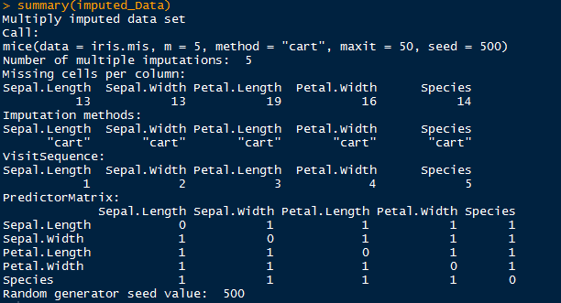
Imputing the Missing Values

Slide 30

Handling Outliers
A general definition by Barnett and Lewis2 defines an outlier in a data set as an observation (or set of observations) which appear to be inconsistent with that set of data.
Note. Outliers do not equal errors. They should be detected, but not necessarily removed. Their inclusion in the analysis is a statistical decision.

Slide 31
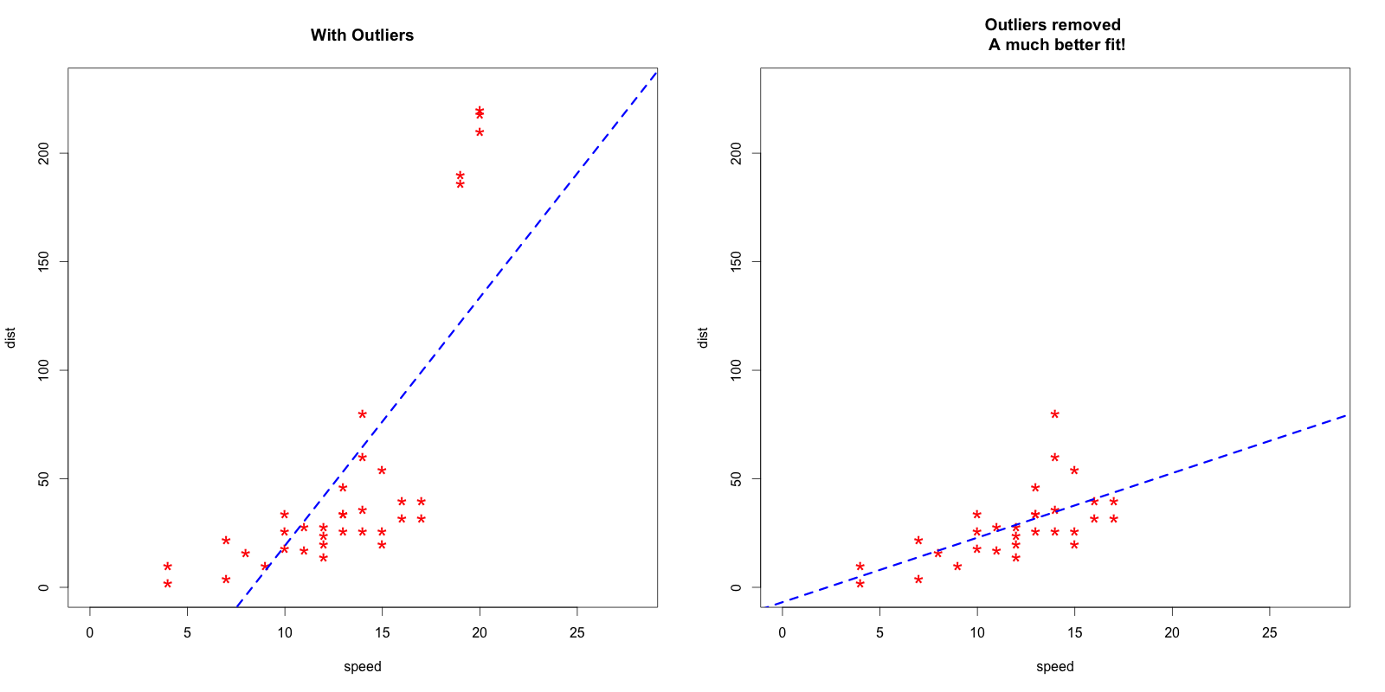
Handling Outliers

Slide 32

Handling Outliers
An obvious inconsistency occurs when a record contains a value or combination of values that cannot correspond to a real-world situation. For example, a person's age cannot be negative, a man cannot be pregnant and an under-aged person cannot possess a drivers license.
Tukey's box-and-whisker method : an observation is an outlier when it is larger than the so-called ``whiskers'' of the set of observations

Slide 33
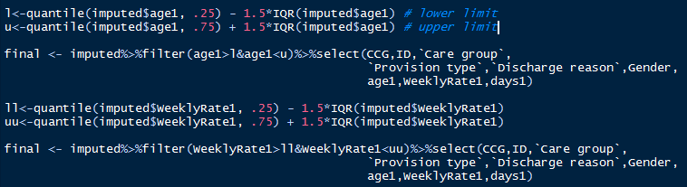

Handling Outliers
Dataset
Variable
Quantile
X times of Quantile
Filter for upper limit and lower limit
Package Outliers

Slide 34
Handling Outliers
Prediction :
The outliers can be replaced with missing values (NA) and then can be predicted by considering them as a response variable

Slide 35
Handling Outliers
Multivariate Model Approach
Cooks Distance: computes the influence exerted by each data point (row) on the predicted outcome.
It measures distance for each observation i measures the change in fitted Y for all the observations with and without presence of I, so we can predict how much the observation I impacted the fitted values.
url <- "http://rstatistics.net/wp-content/uploads/2015/09/ozone.csv"
ozone <- read.csv(url)
mod <- lm(ozone_reading ~ ., data=ozone)
cooksd <- cooks.distance(mod)

Slide 36
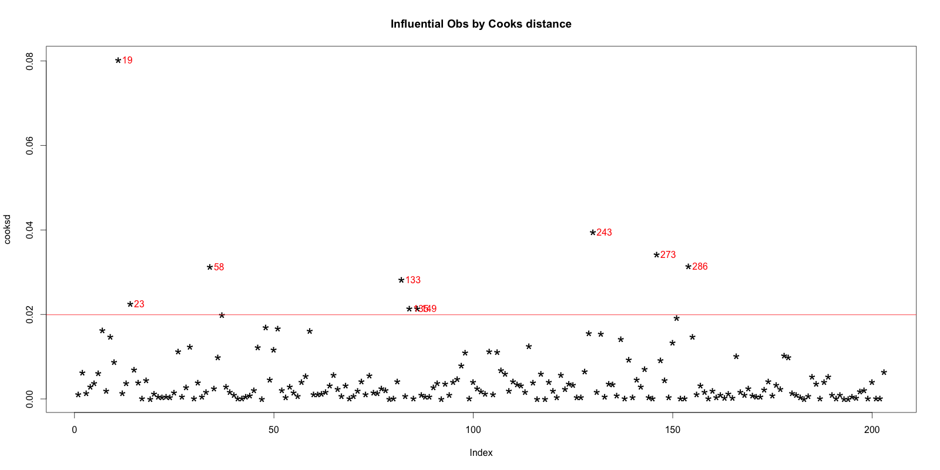
Handling Outliers
Multivariate Model Approach
plot(cooksd, pch="*", cex=2, main="Influential Obs by Cooks distance") # plot cook's distance
abline(h = 4*mean(cooksd, na.rm=T), col="red") # add cutoff line
text(x=1:length(cooksd)+1, y=cooksd,
labels=ifelse(cooksd>4*mean(cooksd, na.rm=T),names(cooksd),""), col="red") # add labels

Slide 37
Handling Outliers
Multivariate Model Approach
find out the influential rows from the original data. If you extract and examine each influential row 1-by-1 (from below output), you will be able to reason out why that row turned out influential. It is likely that one of the X variables included in the model had extreme values.
influential <- as.numeric(names(cooksd)[(cooksd > 4*mean(cooksd, na.rm=T))]) # influential row numbers
head(ozone[influential, ]) # influential observations.
By examining the first 6 rows from above output to find out why these rows could be tagged as influential observations.
Row 58, 133, 135 have very high ozone_reading.
Rows 23, 135 and 149 have very high Inversion_base_height.
Row 19 has very low Pressure_gradient.

Slide 38
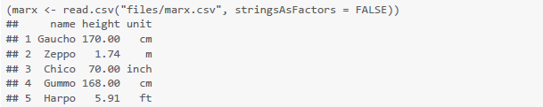
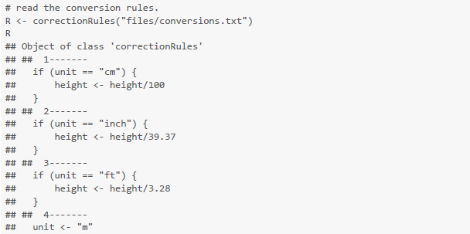
Correction
Transformation Rules –deducorrect package
Inconsistent unit of measurement
Inconsistent unit of measurement

Slide 39
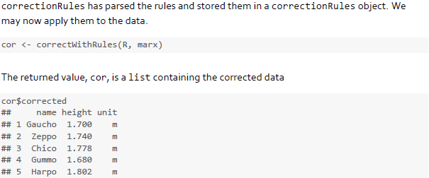
Correction
Transformation Rules –deducorrect package

Slide 40
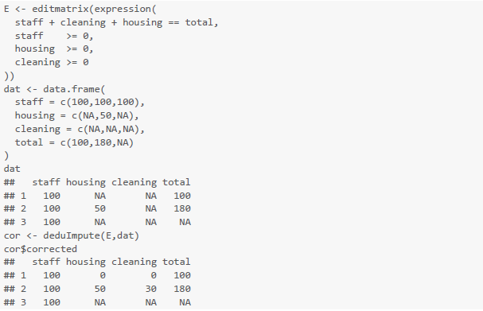
Correction
Deterministic Imputation

Slide 41
Tidy Data
# Installations
# The easiest way to get tidyr is to install the whole tidyverse:
if(!require(tidyverse)){
install.packages("tidyverse")
library(tidyr)
}
# Alternatively, install just tidyr:
if(!require(tidyr)){
install.packages("tidyr")
library(tidyr)
}
library("stringr"); library("reshape2"); library("plyr"); library("dplyr"); library("tidyr");library("tidyverse")

Slide 42
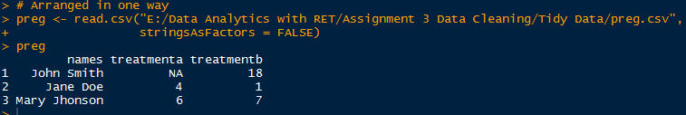
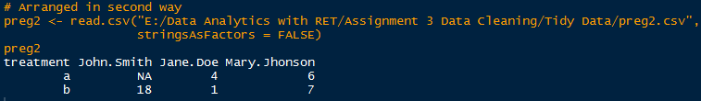
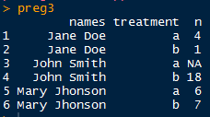
Tidy Data
Tidy Data generated with package “tidyr”

Slide 43
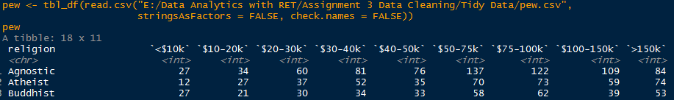
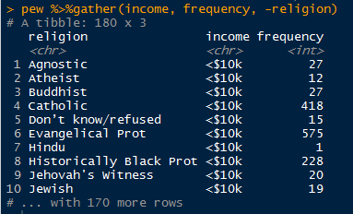
Tidy Data-
Column headers are values, not variable names
Tidy Data generated from Raw Data

Slide 44
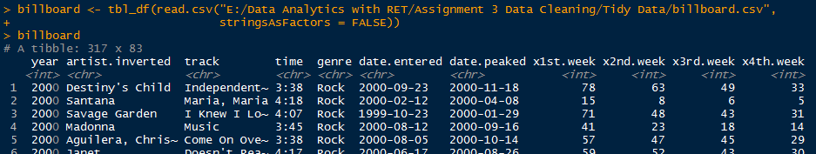
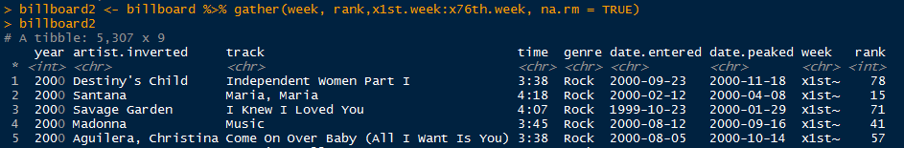
Tidy Data
# To tidy this dataset, we first gather together all the wk columns. The column names give the week and the values are the ranks:
# Here we use na.rm to drop any missing values from the gather columns. In this data, missing values represent weeks that the song wasn't in the charts, so can be safely dropped

Slide 45
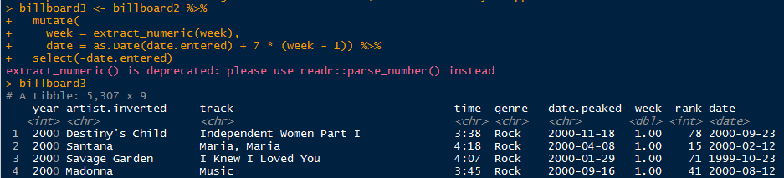
Tidy Data

Slide 46
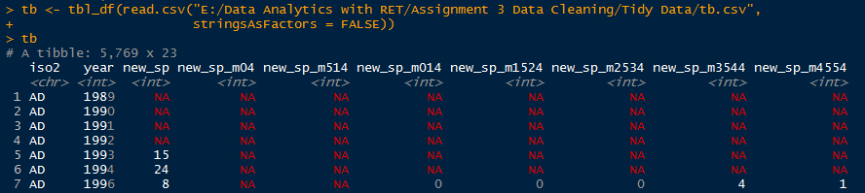
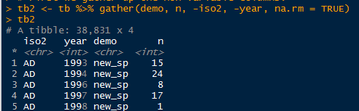
Tidy Data
# Multiple variables stored in one column

Slide 47
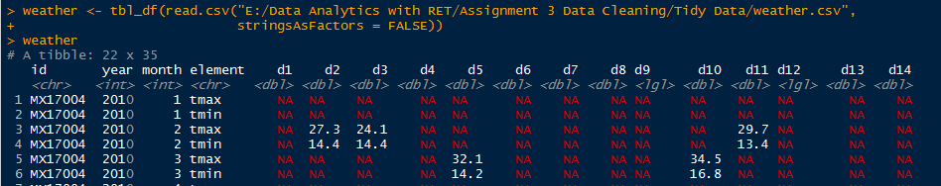
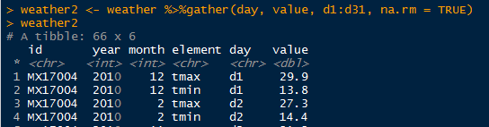
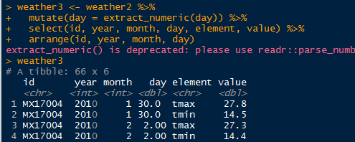
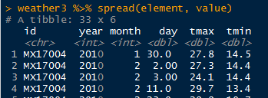
Tidy Data
# Variables are stored in both rows and columns

Slide 48
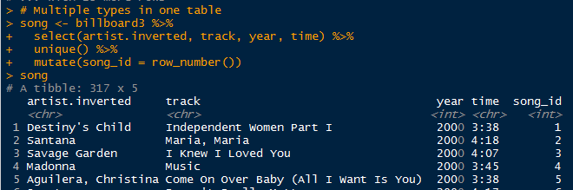
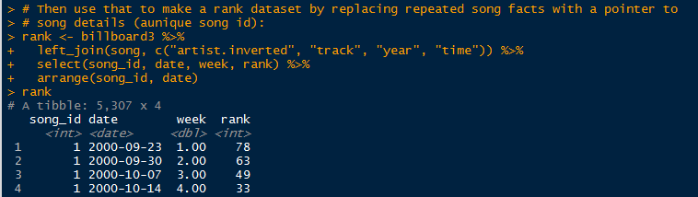
Tidy Data
# Multiple types in one table

Slide 49
Thank You…

